Slide 1
Computer Science
Branch and Bound Algorithm
Samuel Lukas

Slide 2
Introduction
B&B algorithms is an algorithm to solve NP-hard discrete optimization problem. It searches the complete space of solutions for a given problem for the best solution.
At any point during the solution process, the status of the solution with respect to the search of the solution space is described by a pool of yet unexplored subset of this and the best solution found so far. Initially only one subset exists, namely the complete solution space, and the best solution found so far is A. The unexplored subspaces are represented as nodes in a dynamically generated search tree, which initially only contains the root, and each iteration of a classical B&B algorithm processes one such node. The iteration has three main components :
Selection of the node to process
Bound calculation
Branching if needed

Slide 3
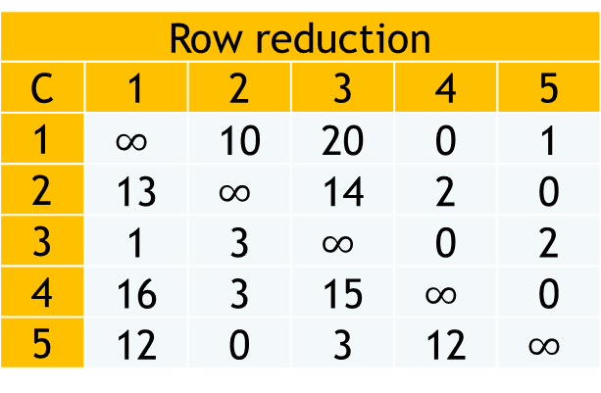
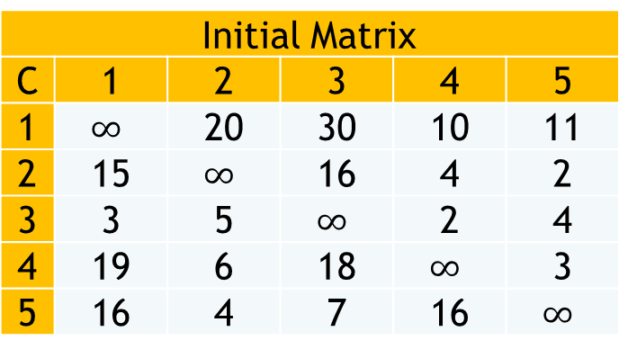

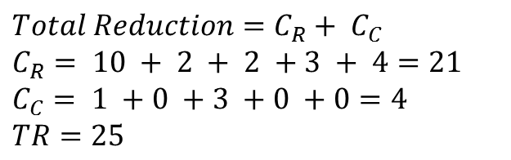
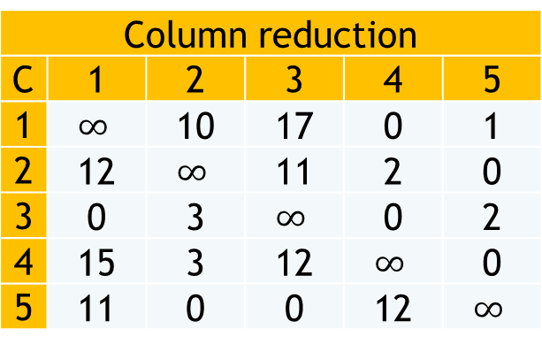
Traveling salesmen Problem Example
Initial Matrix
C | 1 | 2 | 3 | 4 | 5
1 | $$∞$$ | 20 | 30 | 10 | 11
2 | 15 | $$∞$$ | 16 | 4 | 2
3 | 3 | 5 | $$∞$$ | 2 | 4
4 | 19 | 6 | 18 | $$∞$$ | 3
5 | 16 | 4 | 7 | 16 | $$∞$$
Row reduction
C | 1 | 2 | 3 | 4 | 5
1 | $$∞$$ | 10 | 20 | 0 | 1
2 | 13 | $$∞$$ | 14 | 2 | 0
3 | 1 | 3 | $$∞$$ | 0 | 2
4 | 16 | 3 | 15 | $$∞$$ | 0
5 | 12 | 0 | 3 | 12 | $$∞$$
$$Total Reduction=C_{R}+ C_{C}$$
$$C_{R}= 10 + 2 + 2 +3 + 4=21$$
$$C_{C}= 1 +0 +3 +0 +0=4$$
$TR=25$
Column reduction
C | 1 | 2 | 3 | 4 | 5
1 | $$∞$$ | 10 | 17 | 0 | 1
2 | 12 | $$∞$$ | 11 | 2 | 0
3 | 0 | 3 | $$∞$$ | 0 | 2
4 | 15 | 3 | 12 | $$∞$$ | 0
5 | 11 | 0 | 0 | 12 | $$∞$$
$$LB(R)=25$$
1
2
3
4
5

Slide 4


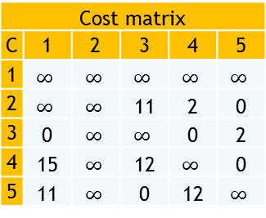
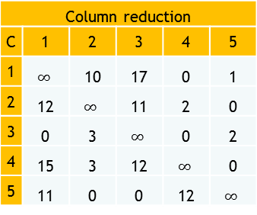
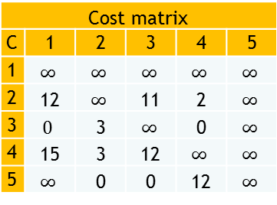



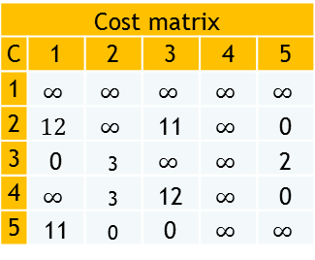



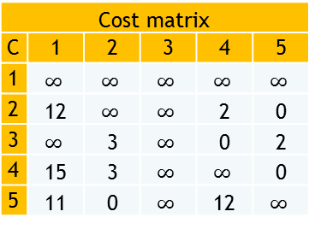


Column reduction
C | 1 | 2 | 3 | 4 | 5
1 | $$∞$$ | 10 | 17 | 0 | 1
2 | 12 | $$∞$$ | 11 | 2 | 0
3 | 0 | 3 | $$∞$$ | 0 | 2
4 | 15 | 3 | 12 | $$∞$$ | 0
5 | 11 | 0 | 0 | 12 | $$∞$$
$$LB(1)=25$$
$$LB\left(x,y\right)=LB\left(x\right)+A\left(x,y\right)+TR$$
1
5
5
3
4
5
3
4
2
3
2
2
$$LB(1,2)=35$$
$$LB(1,2)=53$$
$$LB(1,4)=25$$
$$LB(1,4)=31$$
Cost matrix
C | 1 | 2 | 3 | 4 | 5
1 | $$∞$$ | $$∞$$ | $$∞$$ | $$∞$$ | $$∞$$
2 | $$∞$$ | $$∞$$ | 11 | 2 | 0
3 | 0 | $$∞$$ | $$∞$$ | 0 | 2
4 | 15 | $$∞$$ | 12 | $$∞$$ | 0
5 | 11 | $$∞$$ | 0 | 12 | $$∞$$
Cost matrix
C | 1 | 2 | 3 | 4 | 5
1 | $$∞$$ | $$∞$$ | $$∞$$ | $$∞$$ | $$∞$$
2 | 12 | $$∞$$ | $$∞$$ | 2 | 0
3 | $$∞$$ | 3 | $$∞$$ | 0 | 2
4 | 15 | 3 | $$∞$$ | $$∞$$ | 0
5 | 11 | 0 | $$∞$$ | 12 | $$∞$$
Cost matrix
C | 1 | 2 | 3 | 4 | 5
1 | $$∞$$ | $$∞$$ | $$∞$$ | $$∞$$ | $$∞$$
2 | $$12$$ | $$∞$$ | 11 | $$∞$$ | 0
3 | 0 | 3 | $$∞$$ | $$∞$$ | 2
4 | $$∞$$ | 3 | 12 | $$∞$$ | 0
5 | 11 | 0 | 0 | $$∞$$ | $$∞$$
Cost matrix
C | 1 | 2 | 3 | 4 | 5
1 | $$∞$$ | $$∞$$ | $$∞$$ | $$∞$$ | $$∞$$
2 | 12 | $$∞$$ | 11 | 2 | $$∞$$
3 | $$0$$ | 3 | $$∞$$ | 0 | $$∞$$
4 | 15 | 3 | 12 | $$∞$$ | $$∞$$
5 | $$∞$$ | 0 | 0 | 12 | $$∞$$
$$LB\left(1,2\right)=25+10+0$$
$$LB\left(1,3\right)=25+17+11$$
$$LB\left(1,4\right)=25+0+0$$
$$LB\left(1,4\right)=25+1+5$$

Slide 5
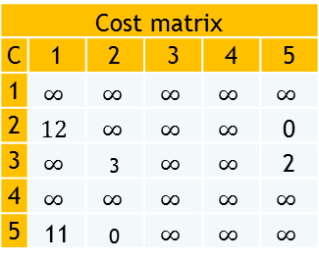





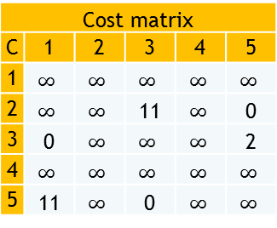
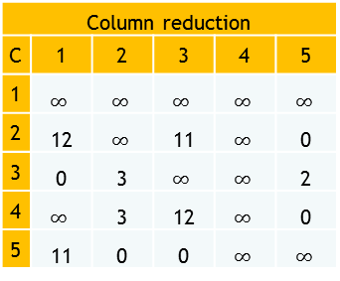


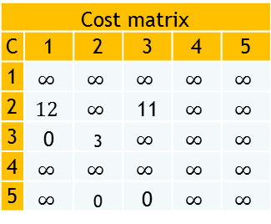
Column reduction
C | 1 | 2 | 3 | 4 | 5
1 | $$∞$$ | $$∞$$ | $$∞$$ | $$∞$$ | $$∞$$
2 | 12 | $$∞$$ | 11 | $$∞$$ | 0
3 | 0 | 3 | $$∞$$ | $$∞$$ | 2
4 | $$∞$$ | 3 | 12 | $$∞$$ | 0
5 | 11 | 0 | 0 | $$∞$$ | $$∞$$
$$LB(R)=25$$
$$LB\left(x,y\right)=LB\left(x\right)+A\left(x,y\right)+TR$$
1
2
3
4
5
$$LB(1,2)=35$$
$$LB(1,2)=53$$
$$LB(1,4)=25$$
$$LB(1,4)=31$$
Cost matrix
C | 1 | 2 | 3 | 4 | 5
1 | $$∞$$ | $$∞$$ | $$∞$$ | $$∞$$ | $$∞$$
2 | $$∞$$ | $$∞$$ | 11 | $$∞$$ | 0
3 | 0 | $$∞$$ | $$∞$$ | $$∞$$ | 2
4 | $$∞$$ | $$∞$$ | $$∞$$ | $$∞$$ | $$∞$$
5 | 11 | $$∞$$ | 0 | $$∞$$ | $$∞$$
$$LB(1,4,2)=28$$
$$LB(1,4,3)=50$$
$$LB(1,4,5)=36$$
2
3
2
3
3
5
5
5
Cost matrix
C | 1 | 2 | 3 | 4 | 5
1 | $$∞$$ | $$∞$$ | $$∞$$ | $$∞$$ | $$∞$$
2 | $$12$$ | $$∞$$ | $$∞$$ | $$∞$$ | 0
3 | $$∞$$ | 3 | $$∞$$ | $$∞$$ | 2
4 | $$∞$$ | $$∞$$ | $$∞$$ | $$∞$$ | $$∞$$
5 | 11 | 0 | $$∞$$ | $$∞$$ | $$∞$$
Cost matrix
C | 1 | 2 | 3 | 4 | 5
1 | $$∞$$ | $$∞$$ | $$∞$$ | $$∞$$ | $$∞$$
2 | $$12$$ | $$∞$$ | 11 | $$∞$$ | $$∞$$
3 | 0 | 3 | $$∞$$ | $$∞$$ | $$∞$$
4 | $$∞$$ | $$∞$$ | $$∞$$ | $$∞$$ | $$∞$$
5 | $$∞$$ | 0 | 0 | $$∞$$ | $$∞$$
$$LB\left(1,4,2\right)=25+3+0$$
$$LB\left(1,4,5\right)=25+0+11$$
$$LB\left(1,4,3\right)=25+12+13$$

Slide 6




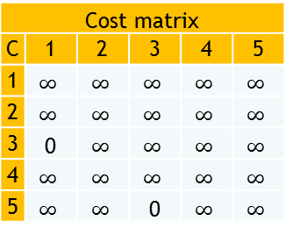


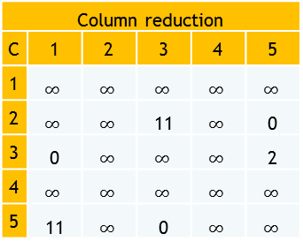
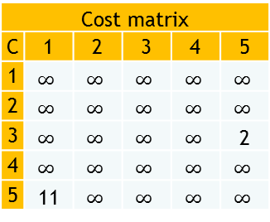



Column reduction
C | 1 | 2 | 3 | 4 | 5
1 | $$∞$$ | $$∞$$ | $$∞$$ | $$∞$$ | $$∞$$
2 | $$∞$$ | $$∞$$ | 11 | $$∞$$ | 0
3 | 0 | $$∞$$ | $$∞$$ | $$∞$$ | 2
4 | $$∞$$ | $$∞$$ | $$∞$$ | $$∞$$ | $$∞$$
5 | 11 | $$∞$$ | 0 | $$∞$$ | $$∞$$
$$LB(R)=25$$
$$LB\left(x,y\right)=LB\left(x\right)+A\left(x,y\right)+TR$$
1
2
3
4
5
$$LB(1,2)=35$$
$$LB(1,2)=53$$
$$LB(1,4)=25$$
$$LB(1,4)=31$$
Cost matrix
C | 1 | 2 | 3 | 4 | 5
1 | $$∞$$ | $$∞$$ | $$∞$$ | $$∞$$ | $$∞$$
2 | $$∞$$ | $$∞$$ | $$∞$$ | $$∞$$ | $$∞$$
3 | $$∞$$ | $$∞$$ | $$∞$$ | $$∞$$ | 2
4 | $$∞$$ | $$∞$$ | $$∞$$ | $$∞$$ | $$∞$$
5 | 11 | $$∞$$ | $$∞$$ | $$∞$$ | $$∞$$
$$LB(1,4,2)=28$$
$$LB(1,4,3)=50$$
$$LB(1,4,5)=36$$
2
3
5
3
3
3
5
5
5
Cost matrix
C | 1 | 2 | 3 | 4 | 5
1 | $$∞$$ | $$∞$$ | $$∞$$ | $$∞$$ | $$∞$$
2 | $$∞$$ | $$∞$$ | $$∞$$ | $$∞$$ | $$∞$$
3 | 0 | $$∞$$ | $$∞$$ | $$∞$$ | $$∞$$
4 | $$∞$$ | $$∞$$ | $$∞$$ | $$∞$$ | $$∞$$
5 | $$∞$$ | $$∞$$ | 0 | $$∞$$ | $$∞$$
$$LB(1,4,2,3)=52$$
3
$$LB\left(1,4,2,3\right)=28+11+13$$
3
$$LB\left(1,4,2,5\right)=28+0+0=28$$
$$LB\left(1,4,2,5,3,1\right)=28+0+0=28$$
$$LB\left(1,4,2,5,3,1\right)=28+0+0=28$$

Slide 7
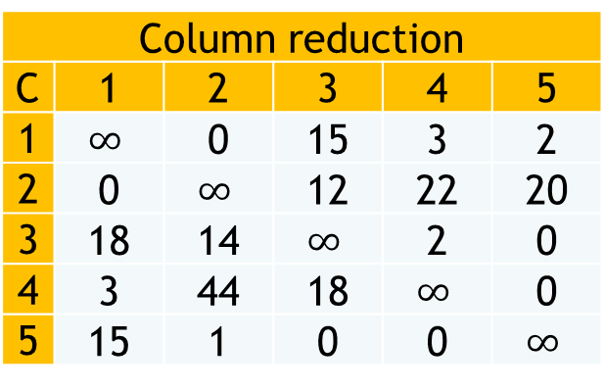
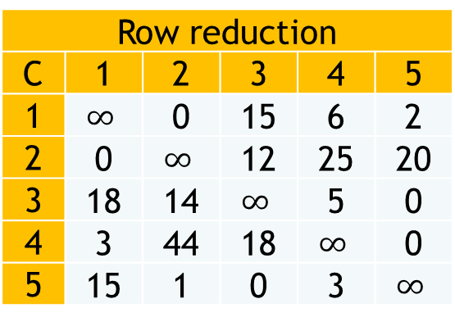
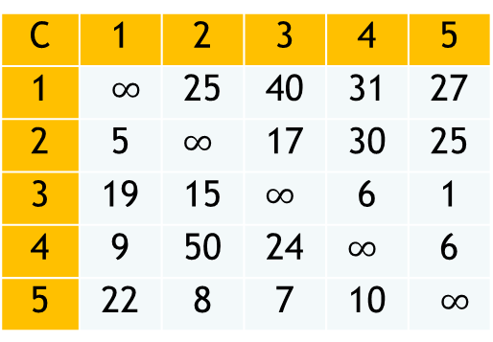

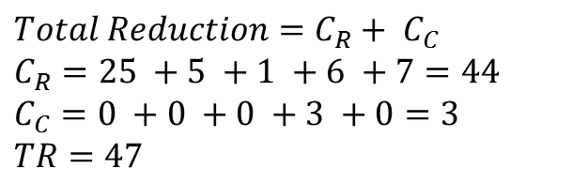
Example 02
C | 1 | 2 | 3 | 4 | 5
1 | $∞$ | 25 | 40 | 31 | 27
2 | 5 | $∞$ | 17 | 30 | 25
3 | 19 | 15 | $∞$ | 6 | 1
4 | 9 | 50 | 24 | $∞$ | 6
5 | 22 | 8 | 7 | 10 | $∞$
Row reduction
C | 1 | 2 | 3 | 4 | 5
1 | $$∞$$ | 0 | 15 | 6 | 2
2 | 0 | $$∞$$ | 12 | 25 | 20
3 | 18 | 14 | $$∞$$ | 5 | 0
4 | 3 | 44 | 18 | $$∞$$ | 0
5 | 15 | 1 | 0 | 3 | $$∞$$
$$Total Reduction=C_{R}+ C_{C}$$
$$C_{R}=25 +5 +1 +6 +7=44$$
$$C_{C}=0 +0 +0 +3 +0=3$$
$TR=47$
Column reduction
C | 1 | 2 | 3 | 4 | 5
1 | $$∞$$ | 0 | 15 | 3 | 2
2 | 0 | $$∞$$ | 12 | 22 | 20
3 | 18 | 14 | $$∞$$ | 2 | 0
4 | 3 | 44 | 18 | $$∞$$ | 0
5 | 15 | 1 | 0 | 0 | $$∞$$
$$LB(R)=47$$
1
2
3
4
5

Slide 8



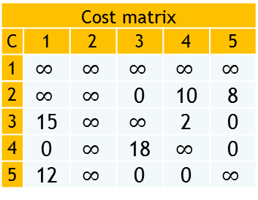





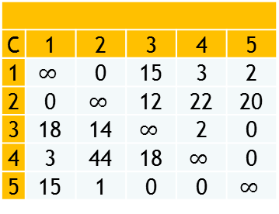


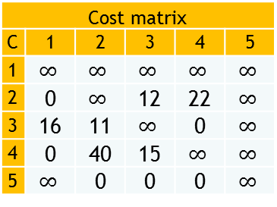



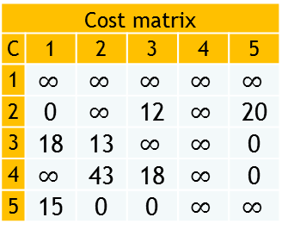

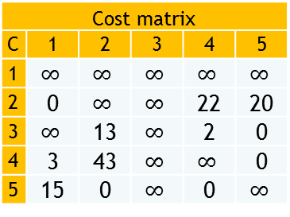



C | 1 | 2 | 3 | 4 | 5
1 | $$∞$$ | 0 | 15 | 3 | 2
2 | 0 | $$∞$$ | 12 | 22 | 20
3 | 18 | 14 | $$∞$$ | 2 | 0
4 | 3 | 44 | 18 | $$∞$$ | 0
5 | 15 | 1 | 0 | 0 | $$∞$$
$$LB(1)=47$$
$$LB\left(x,y\right)=LB\left(x\right)+A\left(x,y\right)+TR$$
1
5
5
3
4
5
3
4
2
3
2
2
$$LB(1,2)=62$$
$$LB(1,3)=63$$
$$LB(1,4)=51$$
$$LB(1,4)=55$$
Cost matrix
C | 1 | 2 | 3 | 4 | 5
1 | $$∞$$ | $$∞$$ | $$∞$$ | $$∞$$ | $$∞$$
2 | $$∞$$ | $$∞$$ | 0 | 10 | 8
3 | 15 | $$∞$$ | $$∞$$ | 2 | 0
4 | 0 | $$∞$$ | 18 | $$∞$$ | 0
5 | 12 | $$∞$$ | 0 | 0 | $$∞$$
Cost matrix
C | 1 | 2 | 3 | 4 | 5
1 | $$∞$$ | $$∞$$ | $$∞$$ | $$∞$$ | $$∞$$
2 | 0 | $$∞$$ | $$∞$$ | 22 | 20
3 | $$∞$$ | 13 | $$∞$$ | 2 | 0
4 | 3 | 43 | $$∞$$ | $$∞$$ | 0
5 | 15 | 0 | $$∞$$ | 0 | $$∞$$
Cost matrix
C | 1 | 2 | 3 | 4 | 5
1 | $$∞$$ | $$∞$$ | $$∞$$ | $$∞$$ | $$∞$$
2 | 0 | $$∞$$ | 12 | $$∞$$ | 20
3 | 18 | 13 | $$∞$$ | $$∞$$ | 0
4 | $$∞$$ | 43 | 18 | $$∞$$ | 0
5 | 15 | 0 | 0 | $$∞$$ | $$∞$$
Cost matrix
C | 1 | 2 | 3 | 4 | 5
1 | $$∞$$ | $$∞$$ | $$∞$$ | $$∞$$ | $$∞$$
2 | 0 | $$∞$$ | 12 | 22 | $$∞$$
3 | 16 | 11 | $$∞$$ | 0 | $$∞$$
4 | 0 | 40 | 15 | $$∞$$ | $$∞$$
5 | $$∞$$ | 0 | 0 | 0 | $$∞$$
$$CR\left(1,2\right)=12$$
$$CR\left(1,2\right)=0$$
$$CR\left(1,2\right)=0$$
$$CR\left(1,2\right)=2+3$$
$$CC\left(1,2\right)=3$$
$$CC\left(1,2\right)=1$$
$$CC\left(1,2\right)=1$$
$$CC\left(1,2\right)=1$$
$$LB\left(1,2\right)=47+15+0$$
$$LB\left(1,3\right)=47+1+15$$
$$LB\left(1,4\right)=47+1+3$$
$$LB\left(1,4\right)=47+6+2$$

Slide 9
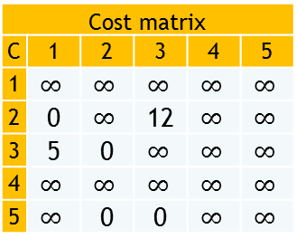



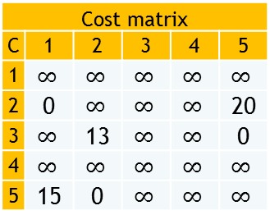
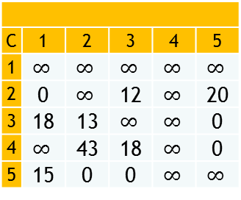






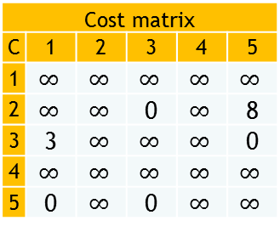



C | 1 | 2 | 3 | 4 | 5
1 | $$∞$$ | $$∞$$ | $$∞$$ | $$∞$$ | $$∞$$
2 | 0 | $$∞$$ | 12 | $$∞$$ | 20
3 | 18 | 13 | $$∞$$ | $$∞$$ | 0
4 | $$∞$$ | 43 | 18 | $$∞$$ | 0
5 | 15 | 0 | 0 | $$∞$$ | $$∞$$
$$LB(R)=47$$
$$LB\left(x,y\right)=LB\left(x\right)+A\left(x,y\right)+TR$$
1
5
2
3
4
5
$$LB(1,2)=62$$
$$LB(1,3)=63$$
$$LB(1,4)=51$$
$$LB(1,4)=55$$
Cost matrix
C | 1 | 2 | 3 | 4 | 5
1 | $$∞$$ | $$∞$$ | $$∞$$ | $$∞$$ | $$∞$$
2 | $$∞$$ | $$∞$$ | 0 | $$∞$$ | 8
3 | 3 | $$∞$$ | $$∞$$ | $$∞$$ | 0
4 | $$∞$$ | $$∞$$ | $$∞$$ | $$∞$$ | $$∞$$
5 | 0 | $$∞$$ | 0 | $$∞$$ | $$∞$$
$$LB(1,4,2)=121$$
$$LB(1,4,3)=69$$
$$LB(1,4,5)=64$$
2
3
2
3
2
3
5
5
Cost matrix
C | 1 | 2 | 3 | 4 | 5
1 | $$∞$$ | $$∞$$ | $$∞$$ | $$∞$$ | $$∞$$
2 | 0 | $$∞$$ | $$∞$$ | $$∞$$ | 20
3 | $$∞$$ | 13 | $$∞$$ | $$∞$$ | 0
4 | $$∞$$ | $$∞$$ | $$∞$$ | $$∞$$ | $$∞$$
5 | 15 | 0 | $$∞$$ | $$∞$$ | $$∞$$
5
Cost matrix
C | 1 | 2 | 3 | 4 | 5
1 | $$∞$$ | $$∞$$ | $$∞$$ | $$∞$$ | $$∞$$
2 | 0 | $$∞$$ | 12 | $$∞$$ | $$∞$$
3 | 5 | 0 | $$∞$$ | $$∞$$ | $$∞$$
4 | $$∞$$ | $$∞$$ | $$∞$$ | $$∞$$ | $$∞$$
5 | $$∞$$ | 0 | 0 | $$∞$$ | $$∞$$
$$CR\left(1,2\right)=13$$
$$CC\left(1,2\right)=0$$
$$CR\left(1,2\right)=12$$
$$LB\left(1,4,5\right)=51+13+0$$
$$CC\left(1,2\right)=15$$
$$LB\left(1,4,2\right)=51+27+43$$
$$LB\left(1,4,3\right)=51+0+18$$

Slide 10



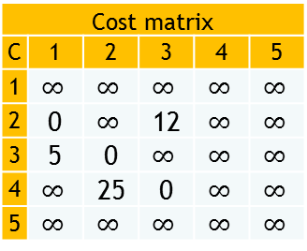



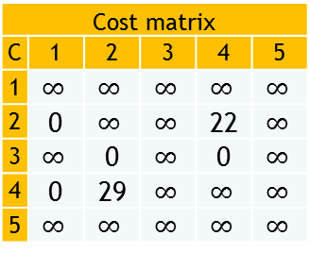

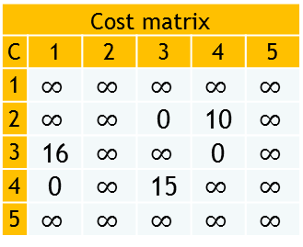


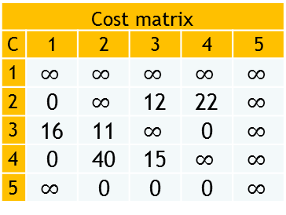


$$LB(R)=47$$
Cost matrix
C | 1 | 2 | 3 | 4 | 5
1 | $$∞$$ | $$∞$$ | $$∞$$ | $$∞$$ | $$∞$$
2 | 0 | $$∞$$ | 12 | 22 | $$∞$$
3 | 16 | 11 | $$∞$$ | 0 | $$∞$$
4 | 0 | 40 | 15 | $$∞$$ | $$∞$$
5 | $$∞$$ | 0 | 0 | 0 | $$∞$$
$$LB\left(x,y\right)=LB\left(x\right)+A\left(x,y\right)+TR$$
1
55
55
62
55
62
63
51
121
69
3
3
64
2
66
67
2
81
4
Cost matrix
C | 1 | 2 | 3 | 4 | 5
1 | $$∞$$ | $$∞$$ | $$∞$$ | $$∞$$ | $$∞$$
2 | $$∞$$ | $$∞$$ | 0 | 10 | $$∞$$
3 | 16 | $$∞$$ | $$∞$$ | 0 | $$∞$$
4 | 0 | $$∞$$ | 15 | $$∞$$ | $$∞$$
5 | $$∞$$ | $$∞$$ | $$∞$$ | $$∞$$ | $$∞$$
Cost matrix
C | 1 | 2 | 3 | 4 | 5
1 | $$∞$$ | $$∞$$ | $$∞$$ | $$∞$$ | $$∞$$
2 | 0 | $$∞$$ | $$∞$$ | 22 | $$∞$$
3 | $$∞$$ | 0 | $$∞$$ | 0 | $$∞$$
4 | 0 | 29 | $$∞$$ | $$∞$$ | $$∞$$
5 | $$∞$$ | $$∞$$ | $$∞$$ | $$∞$$ | $$∞$$
4
Cost matrix
C | 1 | 2 | 3 | 4 | 5
1 | $$∞$$ | $$∞$$ | $$∞$$ | $$∞$$ | $$∞$$
2 | 0 | $$∞$$ | 12 | $$∞$$ | $$∞$$
3 | 5 | 0 | $$∞$$ | $$∞$$ | $$∞$$
4 | $$∞$$ | 25 | 0 | $$∞$$ | $$∞$$
5 | $$∞$$ | $$∞$$ | $$∞$$ | $$∞$$ | $$∞$$
Not optimum yet
$$CR\left(1,2\right)=12$$
$$CR\left(1,2\right)=0$$
$$CC\left(1,2\right)=0$$
$$CC\left(1,2\right)=11$$
$$CR\left(1,2\right)=11+15$$
$$LB\left(1,4,2\right)=55+12+0$$
$$LB\left(1,4,2\right)=55+11+0$$
$$CC\left(1,2\right)=0$$
$$LB\left(1,4,2\right)=55+26+0$$

Slide 11

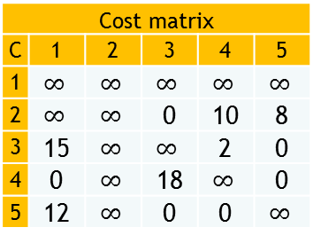


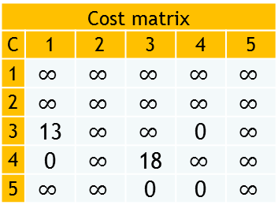



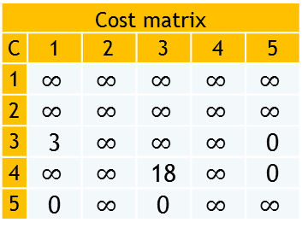



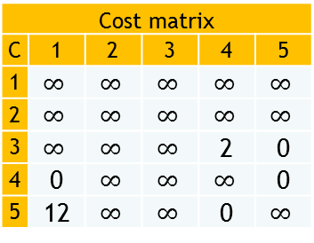
Cost matrix
C | 1 | 2 | 3 | 4 | 5
1 | $$∞$$ | $$∞$$ | $$∞$$ | $$∞$$ | $$∞$$
2 | $$∞$$ | $$∞$$ | 0 | 10 | 8
3 | 15 | $$∞$$ | $$∞$$ | 2 | 0
4 | 0 | $$∞$$ | 18 | $$∞$$ | 0
5 | 12 | $$∞$$ | 0 | 0 | $$∞$$
$$LB(R)=47$$
$$LB\left(x,y\right)=LB\left(x\right)+A\left(x,y\right)+TR$$
1
62
62
63
51
55
62
84
3
4
5
3
5
4
72
121
69
64
67
66
81
Cost matrix
C | 1 | 2 | 3 | 4 | 5
1 | $$∞$$ | $$∞$$ | $$∞$$ | $$∞$$ | $$∞$$
2 | $$∞$$ | $$∞$$ | $$∞$$ | $$∞$$ | $$∞$$
3 | $$∞$$ | $$∞$$ | $$∞$$ | 2 | 0
4 | 0 | $$∞$$ | $$∞$$ | $$∞$$ | 0
5 | 12 | $$∞$$ | $$∞$$ | 0 | $$∞$$
Cost matrix
C | 1 | 2 | 3 | 4 | 5
1 | $$∞$$ | $$∞$$ | $$∞$$ | $$∞$$ | $$∞$$
2 | $$∞$$ | $$∞$$ | $$∞$$ | $$∞$$ | $$∞$$
3 | 3 | $$∞$$ | $$∞$$ | $$∞$$ | 0
4 | $$∞$$ | $$∞$$ | 18 | $$∞$$ | 0
5 | 0 | $$∞$$ | 0 | $$∞$$ | $$∞$$
Cost matrix
C | 1 | 2 | 3 | 4 | 5
1 | $$∞$$ | $$∞$$ | $$∞$$ | $$∞$$ | $$∞$$
2 | $$∞$$ | $$∞$$ | $$∞$$ | $$∞$$ | $$∞$$
3 | 13 | $$∞$$ | $$∞$$ | 0 | $$∞$$
4 | 0 | $$∞$$ | 18 | $$∞$$ | $$∞$$
5 | $$∞$$ | $$∞$$ | 0 | 0 | $$∞$$
$$CR\left(1,2,3\right)=0$$
$$CR\left(1,2,4\right)=0$$
$$CR\left(1,2,5\right)=2$$
$$CC\left(1,2,3\right)=0$$
$$CC\left(1,2,4\right)=12$$
$$CC\left(1,2,5\right)=0$$
$$LB\left(1,2,3\right)=62+0+0$$
$$LB\left(1,2,4\right)=62+12+10$$
$$LB\left(1,2,5\right)=62+2+8$$

Slide 12





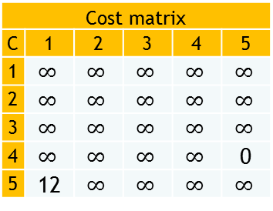

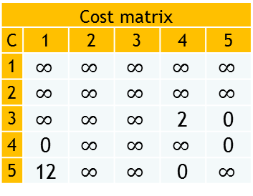
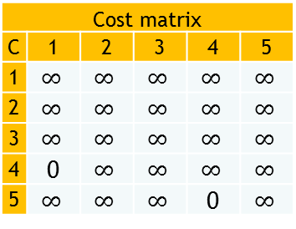
Cost matrix
C | 1 | 2 | 3 | 4 | 5
1 | $$∞$$ | $$∞$$ | $$∞$$ | $$∞$$ | $$∞$$
2 | $$∞$$ | $$∞$$ | $$∞$$ | $$∞$$ | $$∞$$
3 | $$∞$$ | $$∞$$ | $$∞$$ | 2 | 0
4 | 0 | $$∞$$ | $$∞$$ | $$∞$$ | 0
5 | 12 | $$∞$$ | $$∞$$ | 0 | $$∞$$
$$LB(R)=47$$
$$LB\left(x,y\right)=LB\left(x\right)+A\left(x,y\right)+TR$$
1
62
62
63
51
55
62
84
72
62
121
69
64
67
66
81
4
5
Cost matrix
C | 1 | 2 | 3 | 4 | 5
1 | $$∞$$ | $$∞$$ | $$∞$$ | $$∞$$ | $$∞$$
2 | $$∞$$ | $$∞$$ | $$∞$$ | $$∞$$ | $$∞$$
3 | $$∞$$ | $$∞$$ | $$∞$$ | $$∞$$ | $$∞$$
4 | $$∞$$ | $$∞$$ | $$∞$$ | $$∞$$ | 0
5 | 12 | $$∞$$ | $$∞$$ | $$∞$$ | $$∞$$
Cost matrix
C | 1 | 2 | 3 | 4 | 5
1 | $$∞$$ | $$∞$$ | $$∞$$ | $$∞$$ | $$∞$$
2 | $$∞$$ | $$∞$$ | $$∞$$ | $$∞$$ | $$∞$$
3 | $$∞$$ | $$∞$$ | $$∞$$ | $$∞$$ | $$∞$$
4 | 0 | $$∞$$ | $$∞$$ | $$∞$$ | $$∞$$
5 | $$∞$$ | $$∞$$ | $$∞$$ | 0 | $$∞$$
4
62
64
5
Final route is
1 2 3 5 4 1
with total = 62
$$CR\left(1,2,3\right)=0$$
$$CR\left(1,2,3\right)=0$$
$$CC\left(1,2,3\right)=0$$
$$CC\left(1,2,3\right)=0$$
$$LB\left(1,2,3\right)=62+0+2$$
$$LB\left(1,2,3\right)=62+0+0$$

Slide 13
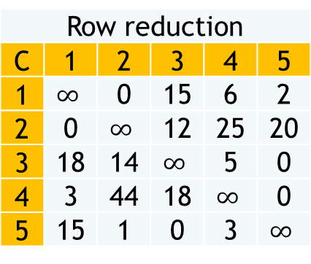
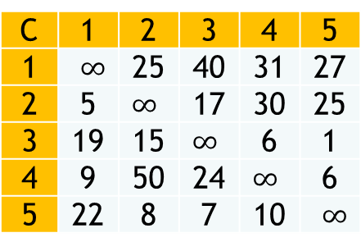
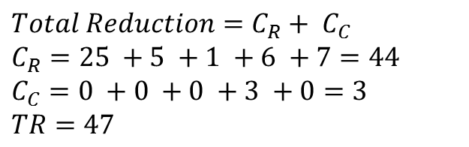
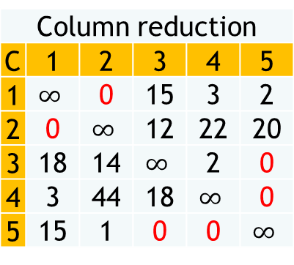
Exercise 2 Other Method
Row reduction
C | 1 | 2 | 3 | 4 | 5
1 | $$∞$$ | 0 | 15 | 6 | 2
2 | 0 | $$∞$$ | 12 | 25 | 20
3 | 18 | 14 | $$∞$$ | 5 | 0
4 | 3 | 44 | 18 | $$∞$$ | 0
5 | 15 | 1 | 0 | 3 | $$∞$$
Column reduction
C | 1 | 2 | 3 | 4 | 5
1 | $$∞$$ | 0 | 15 | 3 | 2
2 | 0 | $$∞$$ | 12 | 22 | 20
3 | 18 | 14 | $$∞$$ | 2 | 0
4 | 3 | 44 | 18 | $$∞$$ | 0
5 | 15 | 1 | 0 | 0 | $$∞$$
C | 1 | 2 | 3 | 4 | 5
1 | $∞$ | 25 | 40 | 31 | 27
2 | 5 | $∞$ | 17 | 30 | 25
3 | 19 | 15 | $∞$ | 6 | 1
4 | 9 | 50 | 24 | $∞$ | 6
5 | 22 | 8 | 7 | 10 | $∞$
$$Total Reduction=C_{R}+ C_{C}$$
$$C_{R}=25 +5 +1 +6 +7=44$$
$$C_{C}=0 +0 +0 +3 +0=3$$
$TR=47$
Best-Node
C | 1 | 2 | 3 | 4 | 5
1 | 0 | 3 | 0 | 0 | 0
2 | 15 | 0 | 0 | 0 | 0
3 | 0 | 0 | 0 | 0 | 4
4 | 0 | 0 | 0 | 0 | 5
5 | 0 | 0 | 12 | 2 | 0
Find Best Node Table by changing all non zero value from column reduction table to zero and zero value by adding the lowest two value from row and column respectively. Best node is largest value from that table.

Slide 14
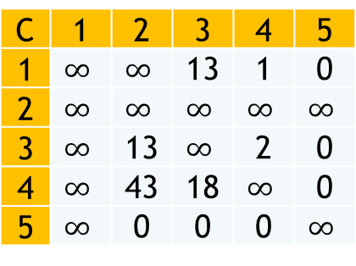







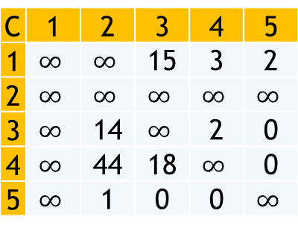

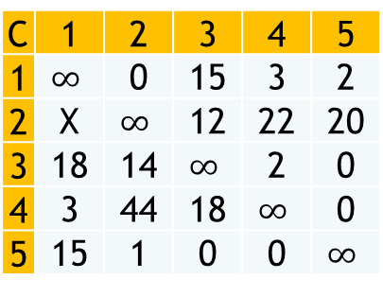


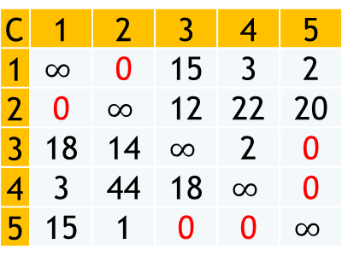


C | 1 | 2 | 3 | 4 | 5
1 | $$∞$$ | 0 | 15 | 3 | 2
2 | 0 | $$∞$$ | 12 | 22 | 20
3 | 18 | 14 | $$∞$$ | 2 | 0
4 | 3 | 44 | 18 | $$∞$$ | 0
5 | 15 | 1 | 0 | 0 | $$∞$$
C | 1 | 2 | 3 | 4 | 5
1 | $$∞$$ | 0 | 15 | 3 | 2
2 | 0 | $$∞$$ | 12 | 22 | 20
3 | 18 | 14 | $$∞$$ | 2 | 0
4 | 3 | 44 | 18 | $$∞$$ | 0
5 | 15 | 1 | 0 | 0 | $$∞$$
C | 1 | 2 | 3 | 4 | 5
1 | $$∞$$ | 0 | 15 | 3 | 2
2 | X | $$∞$$ | 12 | 22 | 20
3 | 18 | 14 | $$∞$$ | 2 | 0
4 | 3 | 44 | 18 | $$∞$$ | 0
5 | 15 | 1 | 0 | 0 | $$∞$$
X
$$LB\left(X\right)=47$$
$$\overline{2,1}$$
$$2,1$$
$$LB\left(Y\right)=LB\left(X\right)+Max(BestNode)$$
$$LB\left(Y\right)=47+15$$
Y
50
62
Z
$$LB\left(Z\right)= ?$$
$$LB\left(Z\right)=50$$
C | 1 | 2 | 3 | 4 | 5
1 | $$∞$$ | $$∞$$ | 15 | 3 | 2
2 | $$∞$$ | $$∞$$ | $$∞$$ | $$∞$$ | $$∞$$
3 | $$∞$$ | 14 | $$∞$$ | 2 | 0
4 | $$∞$$ | 44 | 18 | $$∞$$ | 0
5 | $$∞$$ | 1 | 0 | 0 | $$∞$$
C | 1 | 2 | 3 | 4 | 5
1 | $$∞$$ | $$∞$$ | 13 | 1 | 0
2 | $$∞$$ | $$∞$$ | $$∞$$ | $$∞$$ | $$∞$$
3 | $$∞$$ | 14 | $$∞$$ | 2 | 0
4 | $$∞$$ | 44 | 18 | $$∞$$ | 0
5 | $$∞$$ | 1 | 0 | 0 | $$∞$$
C | 1 | 2 | 3 | 4 | 5
1 | $$∞$$ | $$∞$$ | 13 | 1 | 0
2 | $$∞$$ | $$∞$$ | $$∞$$ | $$∞$$ | $$∞$$
3 | $$∞$$ | 13 | $$∞$$ | 2 | 0
4 | $$∞$$ | 43 | 18 | $$∞$$ | 0
5 | $$∞$$ | 0 | 0 | 0 | $$∞$$
$$C_{R}=2+0+0+0+0$$
$$C_{C}=0+1+0+0+0$$
$$TR=C_{R}+C_{C}=3$$
$$LB(Z)=47+3=50$$

Slide 15
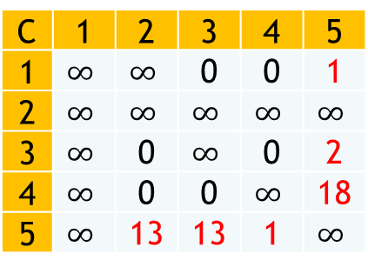
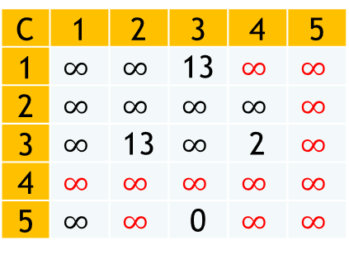












C | 1 | 2 | 3 | 4 | 5
1 | $$∞$$ | $$∞$$ | 13 | 1 | 0
2 | $$∞$$ | $$∞$$ | $$∞$$ | $$∞$$ | $$∞$$
3 | $$∞$$ | 13 | $$∞$$ | 2 | 0
4 | $$∞$$ | 43 | 18 | $$∞$$ | 0
5 | $$∞$$ | 0 | 0 | 0 | $$∞$$
47
C | 1 | 2 | 3 | 4 | 5
1 | $$∞$$ | $$∞$$ | 0 | 0 | 1
2 | $$∞$$ | $$∞$$ | $$∞$$ | $$∞$$ | $$∞$$
3 | $$∞$$ | 0 | $$∞$$ | 0 | 2
4 | $$∞$$ | 0 | 0 | $$∞$$ | 18
5 | $$∞$$ | 13 | 13 | 1 | $$∞$$
$$\overline{2,1}$$
$$2,1$$
62
50
$$\overline{4,5}$$
$$4,5$$
A
B
$$LB\left(A\right)=50+18=68$$
C | 1 | 2 | 3 | 4 | 5
1 | $$∞$$ | $$∞$$ | 13 | $$∞$$ | $$∞$$
2 | $$∞$$ | $$∞$$ | $$∞$$ | $$∞$$ | $$∞$$
3 | $$∞$$ | 13 | $$∞$$ | 2 | $$∞$$
4 | $$∞$$ | $$∞$$ | $$∞$$ | $$∞$$ | $$∞$$
5 | $$∞$$ | $$∞$$ | 0 | $$∞$$ | $$∞$$
C | 1 | 2 | 3 | 4 | 5
1 | $$∞$$ | $$∞$$ | 0 | $$∞$$ | $$∞$$
2 | $$∞$$ | $$∞$$ | $$∞$$ | $$∞$$ | $$∞$$
3 | $$∞$$ | 11 | $$∞$$ | 0 | $$∞$$
4 | $$∞$$ | $$∞$$ | $$∞$$ | $$∞$$ | $$∞$$
5 | $$∞$$ | $$∞$$ | 0 | $$∞$$ | $$∞$$
$$LB\left(B\right)=50+26=76$$
C | 1 | 2 | 3 | 4 | 5
1 | $$∞$$ | $$∞$$ | 0 | $$∞$$ | $$∞$$
2 | $$∞$$ | $$∞$$ | $$∞$$ | $$∞$$ | $$∞$$
3 | $$∞$$ | 0 | $$∞$$ | 0 | $$∞$$
4 | $$∞$$ | $$∞$$ | $$∞$$ | $$∞$$ | $$∞$$
5 | $$∞$$ | $$∞$$ | 0 | $$∞$$ | $$∞$$
$$TR=C_{R}+C_{C}=26$$
$$C_{R}=13+2$$
$$C_{C}=11$$

Slide 16















$$LB\left(A\right)=62$$
47
Cost Matrix
C | 1 | 2 | 3 | 4 | 5
1 | $$∞$$ | 0 | 15 | 3 | 2
2 | 0 | $$∞$$ | 12 | 22 | 20
3 | 18 | 14 | $$∞$$ | 2 | 0
4 | 3 | 44 | 18 | $$∞$$ | 0
5 | 15 | 1 | 0 | 0 | $$∞$$
$$LB\left(B\right)=47+15=62$$
$$\overline{2,1}$$
$$2,1$$
62
50
62
$$\overline{1,2}$$
$$1,2$$
$$\overline{4,5}$$
$$4,5$$
62
62
68
76
A
B
C | 1 | 2 | 3 | 4 | 5
1 | $$∞$$ | $$∞$$ | $$∞$$ | $$∞$$ | $$∞$$
2 | $$∞$$ | $$∞$$ | 12 | 22 | 20
3 | 18 | $$∞$$ | $$∞$$ | 2 | 0
4 | 3 | $$∞$$ | 18 | $$∞$$ | 0
5 | 15 | $$∞$$ | 0 | 0 | $$∞$$
C | 1 | 2 | 3 | 4 | 5
1 | $$∞$$ | $$∞$$ | $$∞$$ | $$∞$$ | $$∞$$
2 | $$∞$$ | $$∞$$ | 0 | 10 | 8
3 | 18 | $$∞$$ | $$∞$$ | 2 | 0
4 | 3 | $$∞$$ | 18 | $$∞$$ | 0
5 | 15 | $$∞$$ | 0 | 0 | $$∞$$
C | 1 | 2 | 3 | 4 | 5
1 | $$∞$$ | $$∞$$ | $$∞$$ | $$∞$$ | $$∞$$
2 | $$∞$$ | $$∞$$ | 0 | 10 | 8
3 | 15 | $$∞$$ | $$∞$$ | 2 | 0
4 | 0 | $$∞$$ | 18 | $$∞$$ | 0
5 | 12 | $$∞$$ | 0 | 0 | $$∞$$
$$C_{C}=3+0+0+0+0$$
$$C_{R}=0+12+0+0+0$$
$$TR=C_{R}+C_{C}=15$$

Slide 17
















$$LB\left(A\right)=62+12=74$$
47
C | 1 | 2 | 3 | 4 | 5
1 | $$∞$$ | $$∞$$ | $$∞$$ | $$∞$$ | $$∞$$
2 | $$∞$$ | $$∞$$ | 0 | 10 | 8
3 | 15 | $$∞$$ | $$∞$$ | 2 | 0
4 | 0 | $$∞$$ | 18 | $$∞$$ | 0
5 | 12 | $$∞$$ | 0 | 0 | $$∞$$
$$LB\left(B\right)=62+0=62$$
$$\overline{2,1}$$
$$2,1$$
62
50
$$\overline{1,2}$$
$$1,2$$
$$\overline{4,5}$$
$$4,5$$
62
62
68
64
62
$$\overline{4,1}$$
$$4,1$$
B
74
62
A
C | 1 | 2 | 3 | 4 | 5
1 | $$∞$$ | $$∞$$ | $$∞$$ | $$∞$$ | $$∞$$
2 | $$∞$$ | $$∞$$ | 8 | 0 | 0
3 | 0 | $$∞$$ | $$∞$$ | 0 | 2
4 | 12 | $$∞$$ | 0 | $$∞$$ | 0
5 | 0 | $$∞$$ | 0 | 2 | $$∞$$
C | 1 | 2 | 3 | 4 | 5
1 | $$∞$$ | $$∞$$ | $$∞$$ | $$∞$$ | $$∞$$
2 | $$∞$$ | $$∞$$ | 0 | $$∞$$ | 8
3 | $$∞$$ | $$∞$$ | $$∞$$ | 2 | 0
4 | $$∞$$ | $$∞$$ | $$∞$$ | $$∞$$ | $$∞$$
5 | $$∞$$ | $$∞$$ | 0 | 0 | $$∞$$
$$C_{R}=0$$
$$C_{C}=0$$
$$TR=C_{R}+C_{C}=0$$

Slide 18













$$LB\left(A\right)=62+10=72$$
47
C | 1 | 2 | 3 | 4 | 5
1 | $$∞$$ | $$∞$$ | $$∞$$ | $$∞$$ | $$∞$$
2 | $$∞$$ | $$∞$$ | 0 | $$∞$$ | 8
3 | $$∞$$ | $$∞$$ | $$∞$$ | 2 | 0
4 | $$∞$$ | $$∞$$ | $$∞$$ | $$∞$$ | $$∞$$
5 | $$∞$$ | $$∞$$ | 0 | 0 | $$∞$$
$$LB\left(B\right)=62+0=62$$
$$\overline{2,1}$$
$$2,1$$
62
50
$$\overline{1,2}$$
$$1,2$$
$$\overline{4,5}$$
$$4,5$$
62
62
68
64
62
$$\overline{4,1}$$
$$4,1$$
62
74
62
A
C | 1 | 2 | 3 | 4 | 5
1 | $$∞$$ | $$∞$$ | $$∞$$ | $$∞$$ | $$∞$$
2 | $$∞$$ | $$∞$$ | $$∞$$ | $$∞$$ | $$∞$$
3 | $$∞$$ | $$∞$$ | $$∞$$ | $$∞$$ | $$∞$$
4 | $$∞$$ | $$∞$$ | $$∞$$ | $$∞$$ | $$∞$$
5 | $$∞$$ | $$∞$$ | $$∞$$ | $$∞$$ | $$∞$$
$$\overline{3,5}$$
$$3,5$$
C | 1 | 2 | 3 | 4 | 5
1 | $$∞$$ | $$∞$$ | $$∞$$ | $$∞$$ | $$∞$$
2 | $$∞$$ | $$∞$$ | 8 | $$∞$$ | 0
3 | $$∞$$ | $$∞$$ | $$∞$$ | 0 | 10
4 | $$∞$$ | $$∞$$ | $$∞$$ | $$∞$$ | $$∞$$
5 | $$∞$$ | $$∞$$ | 0 | 2 | $$∞$$
B
A
62
72
Final route is
1 2 3 5 4 1
with total = 62
$$C_{R}=0$$
$$C_{C}=0$$
$$TR=C_{R}+C_{C}=0$$

Slide 19

Other Example
C | 1 | 2 | 3 | 4 | 5
1 | $∞$ | 10 | 8 | 9 | 7
2 | 10 | $∞$ | 10 | 5 | 6
3 | 8 | 10 | $∞$ | 8 | 9
4 | 9 | 5 | 8 | $∞$ | 6
5 | 7 | 6 | 9 | 6 | $∞$

